Slide 1
Objectives
In this session, you will learn to:
Define polymorphism
Overload functions
Understand operator overloading
Overload unary operators
Overload binary operators
Understand the concept of inheritance
Implement inheritance

Slide 2
Introducing Polymorphism
The term polymorphism has been derived from the
Greek words ‘poly’ and ‘morphos’, which means
‘many’ and ‘forms’, respectively.
In the programming sphere, polymorphism is broadly
divided into two parts:
  Static polymorphism
  Dynamic polymorphism
Static polymorphism refers to an entity existing in
different physical forms simultaneously.

Slide 3
Function Overloading
Is the process of using the same name for two or
more functions.
Requires each redefinition of a function to use a
different function signature that is:
  Different types of parameters
  Sequence of parameters
  Number of parameters
Is used so that a programmer does not have to
remember multiple function names.

Slide 4
Function Signature
The signature of a function is defined by:
  The number of parameters in the function.
  The data types of the parameters.
  The order of the data types of the parameters.
The return type is not a part of a function's signature.

Slide 5
Constructor Overloading
Is commonly used in C++.
Example:
  #include <iostream>
  class Calculator
  {
  int number1, number2, tot;
  public:
  Calculator();//Default Constructor
  Calculator(int,int);//Two-Argument //Constructor
  };

Slide 6
Operator Overloading
Operator overloading refers to providing additional
meaning to the normal C++ operators when they are
applied to user-defined data types.
Only the predefined set of C++ operators can be
overloaded.
Need for Operator Overloading
To make operations on a user-defined data type as
simple as the operations on a built-in data type, they
must be associated with the appropriate set of
operators.

Slide 7
Need for Operator Overloading (Contd.)
The following operators cannot be overloaded:
  Member access(.)
  Pointer to member(.*)
  Scope resolution(::)
  Ternary(?:)
  Sizeof()

Slide 8
  Need for Operator Overloading (Contd.)
  The following operators should not be overloaded,
  since they destroy the meaning of the built-in
  operators:
    The AND logical operator(&&)
    The OR logical operator
    The comma operator

Slide 9
Overloading Unary Operators
Unary operators can be classified as:
  Simple prefix unary operators
  Pre and post increment and decrement operators

Slide 10
Simple Prefix Unary Operators
Are defined by a member function that takes no
parameter or a non-member function that takes one
parameter.
Example:
i1.operator -()
or
operator -(i1)

Slide 11
Simple Prefix Unary Operators (Contd.)
Example:
  #include <iostream>
  class MyInt
  {
  private :
  int a;int b;
  public :
  void operator -();
  void accept(int, int);
  void print();
  };
  void MyInt ::operator –()
  {
  a=-a;b=-b;
  }

Slide 12
Simple Prefix Unary Operators (Contd.)
  void MyInt ::accept(int x, int y)
  {
  a=x;b=y;
  }
  void MyInt ::print()
  {
  cout<<"a="<<a<<endl<<"b="<<b<<endl;
  }
  int main()
  {
  MyInt i1;
  i1.accept(15, -25);
  i1.print();-i1;
  i1.print();
  return 0;
  }

Slide 13
Pre and Post Increment and Decrement Operators
Prefix application of the operator:
  Causes the variable to be incremented before it is used in an expression.
  Causes the operator function with no argument to be invoked by the compiler.
Postfix application of the operator:
  Causes the variable to be incremented after it is used in an expression.
  Causes the operator function with an int argument to be invoked by the compiler.

Slide 14
Pre and Post Increment and Decrement Operators (Contd.)
Example:
  #include<iostream>
  class MyNum
    {
    private:
    int number;
    public:
    ...
    /* Operator */
    MyNum operator ++();//Pre Increment
    MyNum operator ++(int);//Post Increment
    };

Slide 15
Pre and Post Increment and Decrement Operators (Contd.)
  MyNum MyNum ::operator ++()
  //Pre Increment
  {
    MyNum temp;
    number = number + 1;
    //First Increment number
    temp.number = number;
    // Then Assign the Value To temp
    return temp;
    //Return the Incremented Value
    }

Slide 16
Pre and Post Increment and Decrement Operators (Contd.)
    MyNum MyNum ::operator ++(int)
    //Post Increment
    {
    MyNum temp;
    temp.number = number;
    //First Assign the Current Value Of //number To temp
    number = number + 1;
    // Then Increment number
    return temp;
    // Return the Original Value
  }

Slide 17
Overloading Binary Operators
Example:
  #include<iostream>
    class MyNum
    {
    private:
    int number;
    public:
    MyNum(); MyNum(int);
    /* Operator */
    MyNum operator +(MyNum);
    ...
    };

Slide 18
Overloading Binary Operators (Contd.)
  MyNum MyNum ::operator +(MyNum N)
  {
    MyNum temp;
    temp.number = number+N.number;
    return temp;
    }

Slide 19
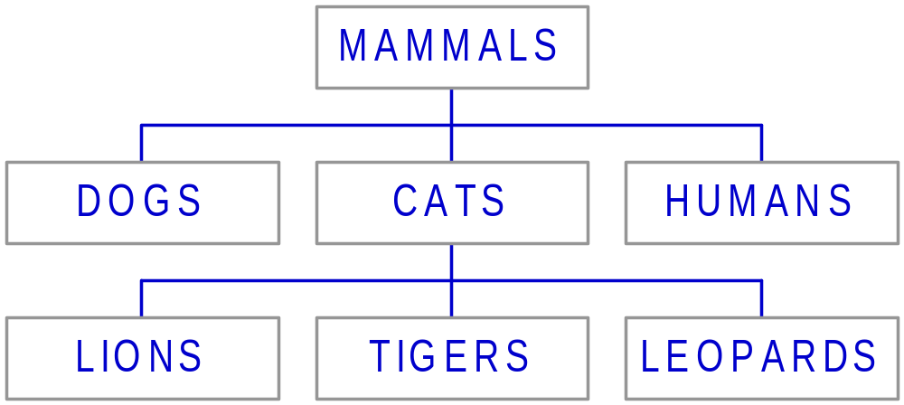
Introducing Inheritance
Inheritance is a capability of one class to inherit properties from another class.
Example:

Slide 20
Superclass and Subclass class
Superclass:
  Is a class from which another class inherits a set of attributes.
Subclass:
  Is a class that inherits a set of attributes from another class.

Slide 21
Types of Inheritance
The types of inheritance are:
Single inheritance:
  Is displayed when a class inherits attributes from a single class.
Multilevel Inheritance:
  Is displayed when a subclass inherits from a class that further inherits from another class.
Multiple inheritance:
  Is displayed when a class inherits attributes from two or more classes.

Slide 22
Generalization
Generalization means that multiple classes inherit
from the same superclass. This ensures that all the
subclasses have a consistent interface.
The single most important reason for generalization is
to create programs that are extensible.
Source reusability is another important reason for a
programmer to generalize.
Generalization is implemented by using an abstract
superclass.

Slide 23
Generalization (Contd.)
When generalizing, the structure and behavior that is
common to different classes are clubbed to form a
common superclass.

Slide 24
Implementing Inheritance
A class that inherits or derives attributes from another
class is called a derived class and the class from
which it is derived is called a base class.
A derived class has a larger set of attributes than its
base class. A derived class can modify some or all
the attributes of the base class.
The main advantages of inheritance are:
  It reduces redundancy in code.
  It enables easy maintenance of code.
  It extends the functionality of an existing class by adding functions to the subclass.

Slide 25
Sequence of Invoking Constructors and Destructors
Constructors are called in the order of
Base-to-Derived.
Destructors are called in the order of
Derived-to-Base.

Slide 26
Base Class Initialization
Is required before the member object initialization of
the derived class is done, as shown in the following
code:
  class Line : public Figure
  { Point p2;
  public:
  Line(int x1 = 0,int y1 = 0,int x2 = 0,int y2 = 0): p2(x2, y2), Figure(x1, y1) {}
  //Member Initialization List
  };

Slide 27
Access Specifiers of Derivation
Falls under the following category:
  public
  protected
  private

Slide 28
Public Access Specifier
Defines that all the:
  private members of a base class remain private in the object.
  protected members remain protected.
  public members remain public.

Slide 29
Protected Access Specifier
Defines that all the:
  private members of a base class remain private in the object.
  protected members remain protected.
  public members of the base class become protected.

Slide 30
Private Access Specifier
Defines that all the:
  private members of a base class remain private in the object.
  public and protected members in the base class become private.
Depicts a composition relationship between the base
and the derived classes.

Slide 31
Demo: Implementing Inheriatance
Problem Statement:
  Furniture and Fittings Company (FFC) deals with custom-made furniture. Customers provide their specifications for the furniture they want. To cope with the volume of orders placed, FFC had decided to computerize their order-processing system a few months ago. The code should have representations for a bookshelf and a chair. You have to develop
  the hierarchy and the code.

Slide 32
Summary
In this session, you learned that:
The term polymorphism has been derived from the Greek words ‘poly’ and ‘morphos’, which means ‘many’ and ‘forms’, respectively.
Function overloading is the process of using the same name for two or more functions.
The number, type, or sequence of parameters for a function is called the function signature.
Static polymorphism is exhibited by a function when it exists in different forms.

Slide 33
Summary (Contd.)
Operator overloading refers to providing additional meaning to the normal C++ operators when they are applied to user-defined data types.
Operator overloading improves the clarity of user-defined data types.
The predefined C++ operators can be overloaded by using the operator keyword.
Operators may be considered as functions internal to the compiler.
Operators may be classified into two types, unary and binary.
Unary operators work with one operand.

Slide 34
Summary (Contd.)
Unary operators can be classified as:
  Simple prefix unary operators, for example, ! and -
  Pre and post increment and decrement operators
A prefix unary operator may be defined by a member function taking no parameter or a non-member function taking one parameter.
In order to avoid confusion between pre and post-fix operators, all post-fix unary operators take in a dummy integer.
Binary operators work with two operands.

Slide 35
Summary (Contd.)
Overloading a binary operator is similar to
overloading a unary operator except that a binary operator requires an additional parameter.
In order to understand their overloading better, binary operators may be classified as follows:
  Simple operators, like + - * / % += -=
  Comparison operators, like < > <= >= != ==
  The assignment operator =
  The insertion and extraction operator << >>

Slide 36
Summary (Contd.)
Generalization means that multiple classes inherit
from the same superclass.
When a class inherits a set of attributes from another
class, the class that inherits is called the subclass
and the class from which it inherits is called the
superclass.
An abstract superclass is a conceptual class that
does not exist in the real world but acts as a base
from which other classes inherit properties.

Slide 37
Summary (Contd.)
When a class inherits attributes from two or more
classes, it is said to be showing multiple inheritance.
In a class hierarchy, constructors are called in the
order of Base–to–Derived and destructors are
called in the order of Derived–to–Base.

